Slide 1
Unit 4
Polymorphism
Total Lecture Hour:9hrs
Prepared by
Er.Harendra Bikram Shah
[Lecturer]
Department of BE Computer
NAST,Dhangadhi

Slide 2
OUTLINES
  Introduction to Polymorphism
  Types of Polymorphism: Compile Time Polymorphism: Function Overloading, Operator Overloading Runtime Polymorphism: Virtual Function
  Overloading Unary and Binary Operators
  Function Overriding
  this Pointer and Object Pointer
  Pure Virtual Function, Abstract Class
  Virtual Destructor
  Type Conversion: Basic to User-Defined, User-Defined to Basic, User-defined to User-Defined

Slide 3
  Introduction to Polymorphism
Greek word :
Poly=many
Morphos=Forms
Same object with different behaviour
Function overloading ,Operator overloading and Virtual Function are part of Polymorphism

Slide 4
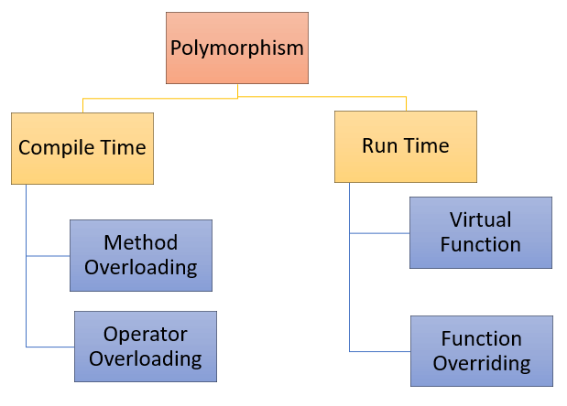
Types of Polymorphism

Slide 5
Function/Method Overloading
#include<iostream.h>
using namespace std;
class demo
{
public:
// Function with 1 int parameter
void fun(int x)
{
cout << "value of x is " << x << endl;
}
// Function with same name but
// 1 double parameter
void fun(double x)
{
cout << "value of x is " << x << endl;
}
};
//Main function
int main()
{
demo obj1;
obj1.fun(5);
// fun() is called with double value
obj1.fun(5.1);
return 0;
}

Slide 6
Operator Overloading
Unary and Binary Operator overloading
Can be achieved using
Class function
Friend function
We cannot overload these operator
. Dot Operator
:: Scope resolution operator
?: Conditional operator
Sizeof() operator

Slide 7
Operator Overloading
#include<iostream>
using namespace std;
class demo{
int a,b;
public:
demo(int x,int y)
{
a=x;
b=y;
}
void operator -()
{
a--;
b--;
cout<<"A="<<a<<" "<<"B="<<b<<endl;
}
};
int main()
{
demo d(10,20);
-d;
return 0;
}

Slide 8
Run Time Polymorphism
Function Overriding
#include <iostream>
using namespace std;
class Demo{
public:
void fun()
{
cout << “I am from base class";
}
};
class dd: public Demo{
public:
void fun()
{
cout << “I am from derived class";
}
};
int main(void)
{
dd c;
c.fun();
return 0;
}

Slide 9
VIRTUAL FUNCTION
#include <iostream>
using namespace std;
class Demo{
public:
virtual void fun()
{
cout << “I am from base class";
}
};
class dd: public Demo{
public:
void fun()
{
cout << “I am from derived class";
}
};
int main(void)
{
dd c;
Demo *p;
p=&c;
p->fun()
return 0;
}
If we do not add virtual keyword then the fun() of base class will be executed but if we add virtual in base class then the fun of derived class will be executed

Slide 10
PURE VIRTUAL FUNCTION
Virtual function that has no definition .
Starts with virtual keyword and end with equals to 0;
We have to override the pure virtual function in derived class otherwise we will get compile time error.
We cant change the signature of pure virtual function.
We cannot create the object of the class where pure virtual function is defined.
Example:
Virtual void show()=0;

Slide 11
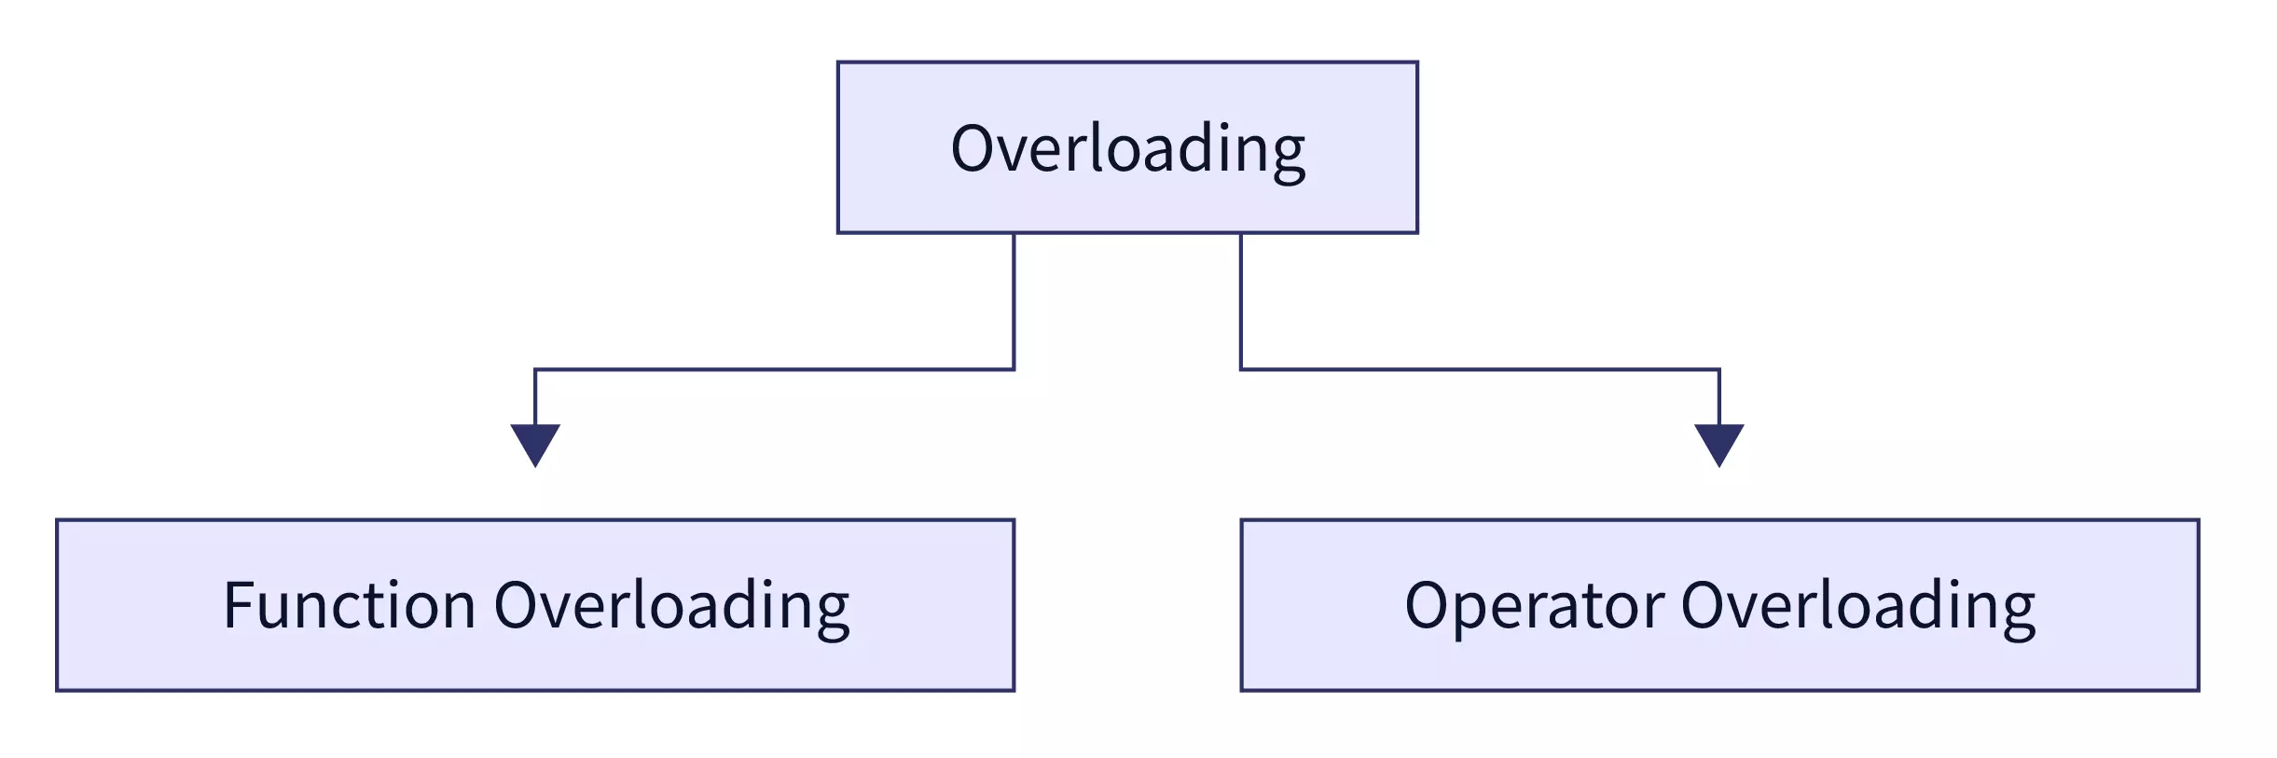
Introduction to Operator Overloading
Operator overloading in C++ is a feature that allows to define and use operators with user-defined data types.
It enables to extend the functionality of existing operators or create new operators for custom classes.
In other words, we can redefine the meaning of an operator when applied to objects of a particular class.

Slide 12
Introduction to Operator Overloading
We cannot overload these operator
Scope operator (::)
Sizeof
member selector(.)
member pointer selector(*)
ternary operator(?:)
Syntax of Operator Overloading
return_type class_name : : operator op(argument_list)
{
// body of the function.
}
Where the return type is the type of value returned by the function.
class_name is the name of the class.
operator op is an operator function where op is the operator being overloaded, and the operator is the keyword.

Slide 13
Types of Operator Overloading
Operators that can be overloaded | Examples
Binary Arithmetic | +, -, *, /, %
Unary Arithmetic | +, -, ++, —
Assignment | =, +=,*=, /=,-=, %=
Bitwise | & , | , << , >> , ~ , ^
De-referencing | (->)
Dynamic memory allocation, De-allocation | New, delete
Subscript | [ ]
Function call | ()
Logical | &, | |, !
Relational | >, < , = =, <=, >=

Slide 14
Unary Operator Overloading
Operator having only one operand
Example : -,--,++,+
Syntax:
class className {
...
public
returnType operator <symbol> (<parameters>) {
...
}
...
};

Slide 15
Unary Operator Overloading
// C++ program to show unary operator overloading
#include <iostream>
using namespace std;
class Distance {
public:
int x;
// Constructor to initialize
// the object's value
Distance(int y)
{
x=y;
}
// Overloading(-) operator to
// perform decrement operation
void operator-()
{
--x;
cout << "Decrement in value of X" <<x ;
}
};
int main()
{
Distance d1(8);
// Use (-) unary operator by
// single operand
-d1;
return 0;
}

Slide 16
Binary Operator Overloading
Syntax of the Binary Operator Overloading
Following is the Binary Operator Overloading syntax in the C++ Programming language
return_type :: operator binary_operator_symbol (arg)
{
// function definition
}
return_type: It defines the return type of the function.
operator: It is a keyword of the function overloading.
binary_operator_symbol: It represents the binary operator symbol that overloads a function to perform the calculation.
arg: It defines the argument passed to the function.

Slide 17
Binary Operator Overloading
#include <iostream>
using namespace std;
class Complex_num
{
// declare data member or variables
int x, y;
public:
// create a member function to take input
void inp()
{
cout << " Input two complex number: " << endl;
cin >> x >> y;
}
// use binary '+' operator to overload
Complex_num operator + (Complex_num obj)
{
// create an object
Complex_num A;
// assign values to object
A.x = x + obj.x;
A.y = y + obj.y;
return (A);
}
// overload the binary (-) operator
Complex_num operator - (Complex_num obj)
{
// create an object
Complex_num A;
// assign values to object
A.x = x - obj.x;
A.y = y - obj.y;
return (A);
}
// display the result of addition
void print()
{
cout << x << " + " << y << "i" << "\n";
}
// display the result of subtraction
void print2()
{
cout << x << " - " << y << "i" << "\n";
}
};

Slide 18
int main ()
{
Complex_num x1, y1, sum, sub; // here we created object of class Addition i.e x1 and y1
// accepting the values
x1.inp();
y1.inp();
// add the objects
sum = x1 + y1;
sub = x1 - y1; // subtract the complex number
// display user entered values
cout << "\n Entered values are: \n";
cout << " \t";
x1.print();
cout << " \t";
y1.print();
cout << "\n The addition of two complex (real and imaginary) numbers: ";
sum.print(); // call print function to display the result of addition
cout << "\n The subtraction of two complex (real and imaginary) numbers: ";
sub.print2(); // call print2 function to display the result of subtraction
return 0;
}

Slide 19
this pointer and object pointer
this pointer or this keyword
#include<iostream>
using namespace std;
/* local variable is same as a member's name */
class Test
{
int x;
public:
void set (int x)
{
// The 'this' pointer is used to retrieve the object's x
// hidden by the local variable 'x'
this->x = x;
}
void print()
{
cout << "x = " << x << endl;
}
};
int main()
{
Test obj;
obj.set(10);
obj.print();
return 0;
}

Slide 20
object pointer
#include<iostream>
using namespace std;
class Test
{
int x,y;
public:
void set (int a,int b)
{
x=a;
y=b;
}
void show()
{
cout<<"A="<<x<<" "<<"B="<<y<<endl;
}
};
int main()
{
Test obj;
Test *p;
p=&obj;
(*p).set(10,20);
p->show();
return 0;
}

Slide 21
Abstract class/Function
A class that contains at least one pure virtual function
Here we cant declare any object of abstract class
Syntax:
Class A
{
Public:
Virtual void show()=0;
....
.....
};

Slide 22
Example of Abstract Class /Function
#include <iostream>
using namespace std;
class Base {
public:
// pure virtual function
virtual void fun() = 0;
void show()
{
cout<<"i am from base class"<<endl;
}
};
// This class inherits from Base and implements fun()
class Derived : public Base {
public:
void fun()
{
cout<<"i am from derived class"<<endl;
}
};
int main()
{
Derived d;
//calling the fun() function of Derived class
d.fun();
d.show();
return 0;
}

Slide 23
Example of Abstract Class /Function using Pointer Object
#include <iostream>
using namespace std;
class Base {
public:
// pure virtual function
virtual void fun() = 0;
void show()
{
cout<<"i am from base class"<<endl;
}
};
// This class inherits from Base and implements fun()
class Derived : public Base {
public:
void fun()
{
cout<<"i am from derived class"<<endl;
}
};
int main()
{
Derived d;
Base *p;
p=&d;
p->fun(); // calling the fun() function of Derived class
return 0;
}

Slide 24
VIRTUAL DESTRUCTOR
#include<iostream>
using namespace std;
class base {
public:
base()
{
cout << "Constructing base\n";
}
virtual ~base()
{
cout << "Destructing base\n";
}
};
class derived : public base
{
public: derived()
{
cout << "Constructing derived\n";
}
virtual ~derived()
{
cout << "Destructing derived\n";
} };
int main()
{
derived *d = new derived();
base *b = d;
delete b;
getchar();
return 0; }

Slide 25
Type Conversion
C++ provides mechanism to perform automatic type conversion if all variable are of basic type.
For user defined data type, programmers have to convert it by using constructor or by using casting operator.
Automatic type conversion
Example:
int x;
float y = 20.123;
x=y ;
When objects are of different data types we must apply conversion rules for assignment.
Three type of situation arise in user defined data type conversion.
Basic type to Class type
Class type to Basic type
Class type to Class type

Slide 26
#include<iostream>
using namespace std;
class complex
{
int a,b;
public:
complex() //default constructor
{
}
complex(int k)//parameterized constructor
{
a=k;
b=0;
}
void setdata(int x,int y)
{
a=x;
b=y;
}
void show()
{
cout <<"aR="<<a<<endl;
cout <<"bI="<<b<<endl;
}
};
Basic type(Primitive) To Class type
Through Constructor
int main()
{
complex c;
int x=5;
c=x; //invokes constructor
c.show();
return 0;
}

Slide 27
#include<iostream>
using namespace std;
class complex
{
int a,b;
public:
void setdata(int x,int y)
{
a=x;
b=y;
}
void show()
{
cout <<"aR="<<a<<endl;
cout <<"bI="<<b<<endl;
}
operator int()
{
return(a);
}
};
Class type to Basic type
Through Casting Operator
int main()
{
complex c;
c.setdata(3,4);
c.show();
int x=c; //x=c1.operator int();
cout<<"x="<<x<<endl;
return 0;
}

Slide 28
#include<iostream>
using namespace std;
class product
{
int m,n;
public:
void setdata(int x,int y)
{
m=x;
n=y;
}
int getm()//function to get the value of m and n
{
return (m);
}
int getn()
{
return (n);
}
void show()
{
cout <<"m="<<m<<endl;
cout <<"n="<<n<<endl;
}};
Class type to Class type
Through Constructor and Casting Operator
class item
{
private:
int a,b;
public:
item () {}
item(product p1){
a=p1.getm();
b=p1.getn();}
void show()
{
cout <<"aR="<<a<<“ib=”<<b<<endl;
}};
int main()
{
item i1;
product p1;
p1.setdata(3,4);
i1=p1;
i1.show();
return 0;}

Slide 29
#include<iostream>
using namespace std;
class item
{
public:
int a,b;
public:
void show(){
cout <<"aR="<<a<<“ib=”<<b<<endl;}};
class product
{
int m,n;
public:
void setdata(int x,int y){
m=x;
n=y;}
void show(){
cout <<"m="<<m<<“n”<<endl;}
operator item()
{
item c;
c.a=m;
c.b=n;
return(c);
}};
Class type to Class type
Through Casting Operator
int main()
{
item i1;
product p1;
p1.setdata(3,4);
i1=p1;
i1.show();
return 0;
}

Slide 30
THANK YOU

